Slide 1
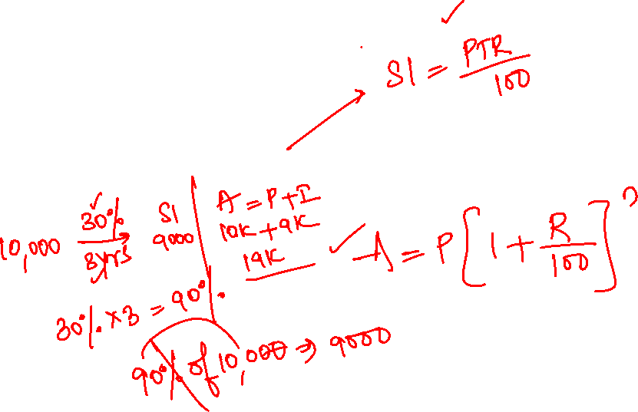
Simple Interest
Quantitative Aptitude

Slide 2
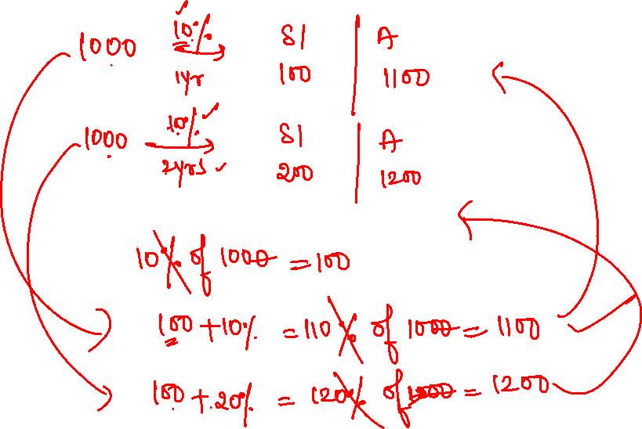

Slide 4
1. What will be the Simple interest on a sum of Rs. 1500 at the rate of 15% per annum for 2 years
Rs. 450
Rs. 300
Rs. 600
Rs. 950

Slide 5
2. What will be the Simple interest on a sum of Rs. 10,000 at the rate of 20% per annum for 5 years
Rs. 15,000
Rs. 30,000
Rs. 10,000
Rs. 14,500

Slide 6
3. The simple interest at 30% for 3 years will be Rs.270. Find the Sum?
Rs. 550
Rs. 680
Rs. 200
Rs. 300

Slide 7
4. At what sum simple interest is Rs. 90 at the rate of 6% in 3 years?
Rs. 270
Rs. 500
Rs. 540
Rs. 720

Slide 8
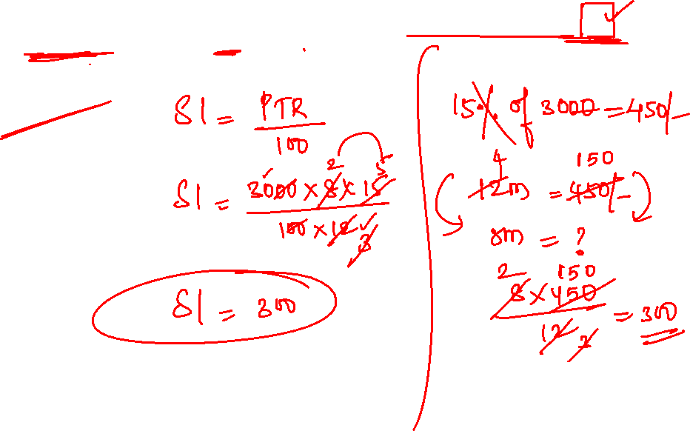
5. What will be the simple interest earned on amount of Rs. 3000 in 8 months at the end of 15% per annum?
500
300
200
600

Slide 9
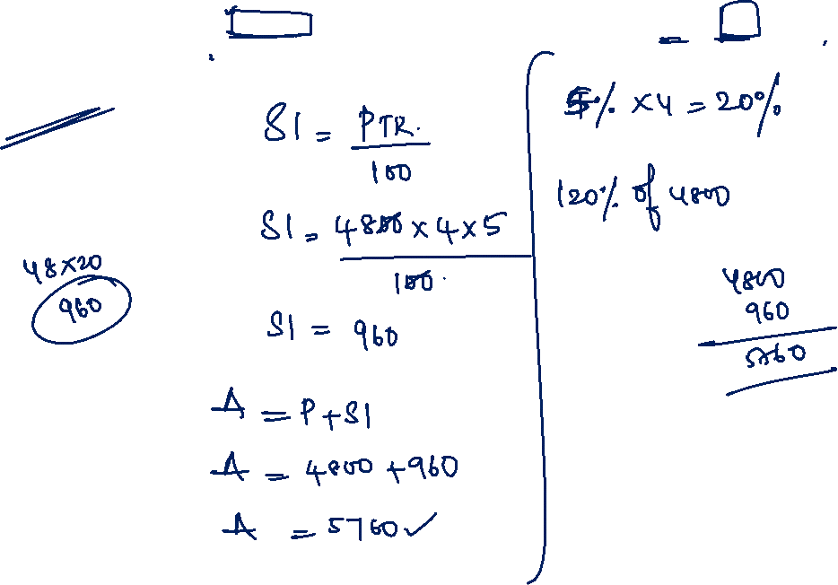
6. What will be the amount earned on Principal amount of Rs. 4800 in 4 years the rate of 5% per annum?
Rs. 4500
Rs. 5760
Rs. 8200
Rs. 2800

Slide 10
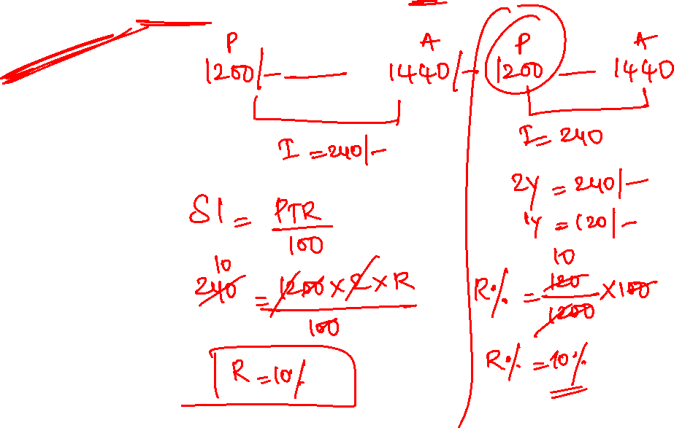
7. Find the rate of interest if the amount after 2 years of simple interest on a capital of Rs.1200 is Rs.1440.
10%
20%
15%
5%

Slide 11
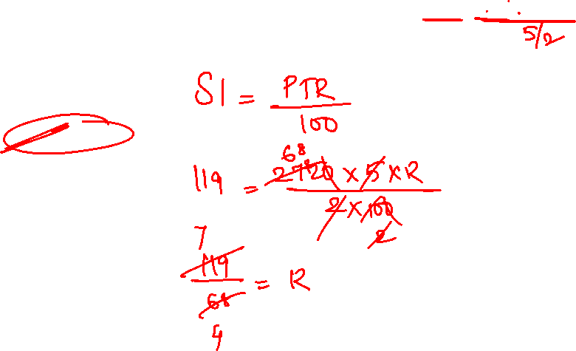
8. A sum of Rs. 2720 gives a Simple Interest of Rs. 119 in 2(1/2) years, the rate of interest per annum
2/5%
3/2%
7/4%
4/5%

Slide 12
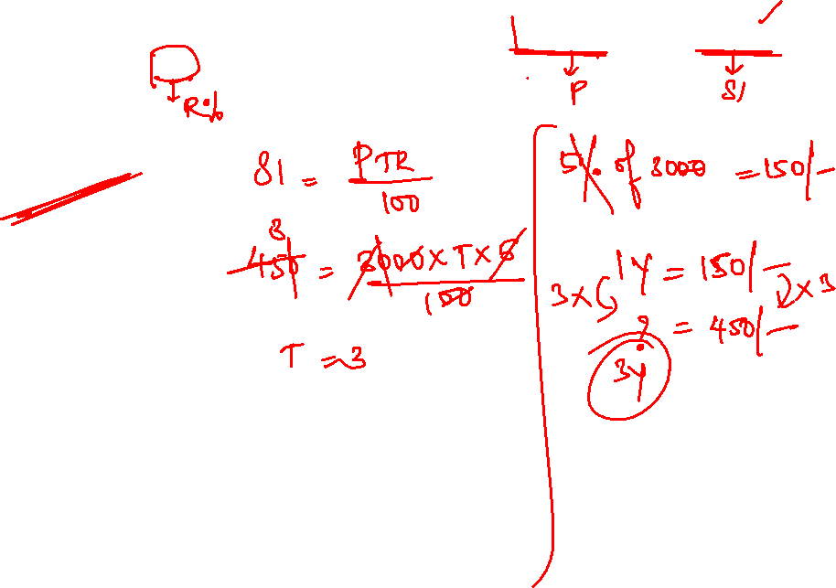
9. In how many years will it take an amount of Rs. 3000 to yield Rs.450 as interest at 5% per annum Simple Interest
5 years
4 years
3 years
2 years

Slide 13
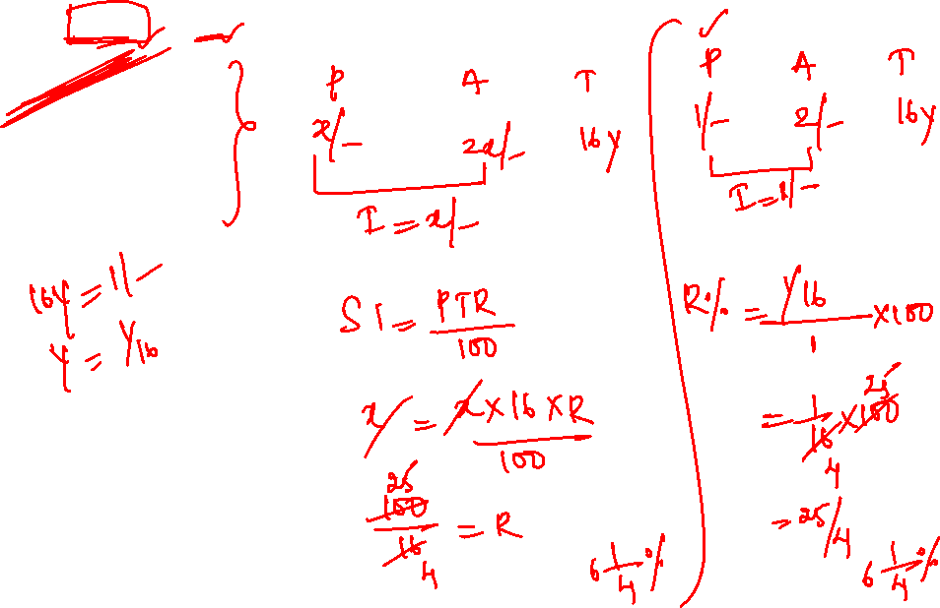
10. At what rate percent per annum simple interest will a sum of money double in 16 years?
6(1/4)%
25%
2(1/5)%
3(1/4)%

Slide 14
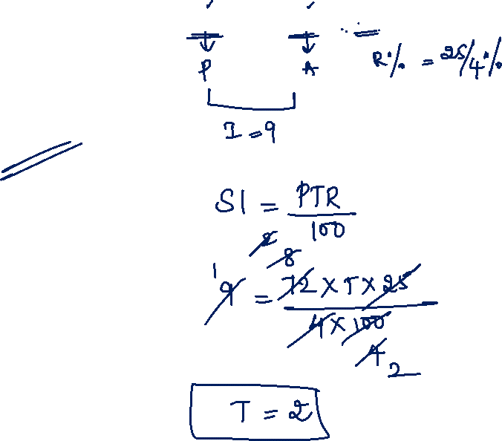
11. In what time will 72 become 81 at 6(1/4)% per annum is
5 years
3 years
1 year
2 years

Slide 15
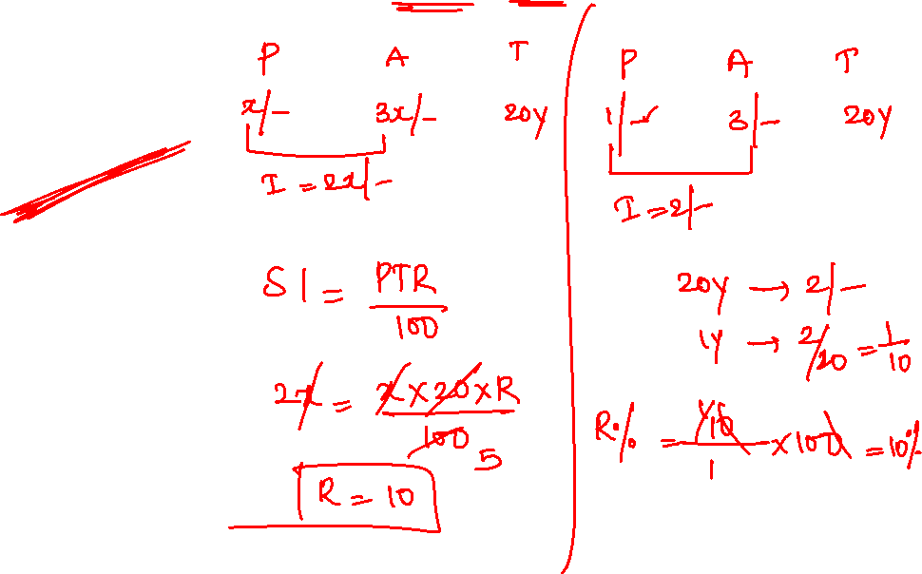
12. If a sum of money becomes triples in 20 years find the rate of interest per annum is
20%
25%
15%
10%

Slide 16
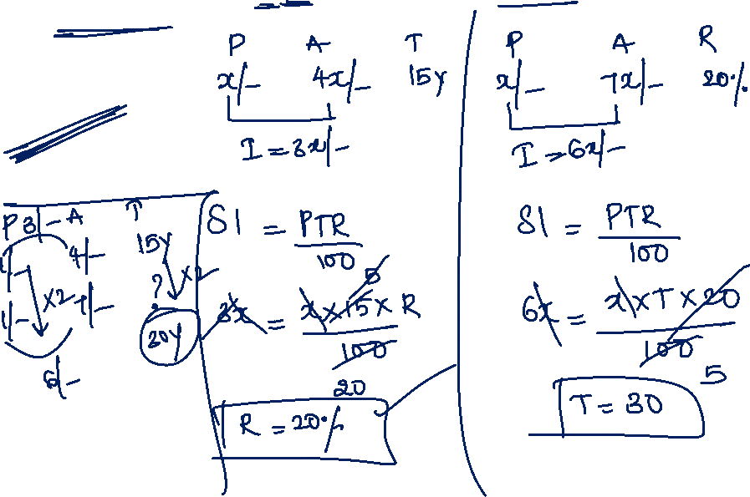
13. A sum of money at SI 4 times itself in 15 years, 7 times itself in how many years?
20 years
25 years
30 years
45 years

Slide 17
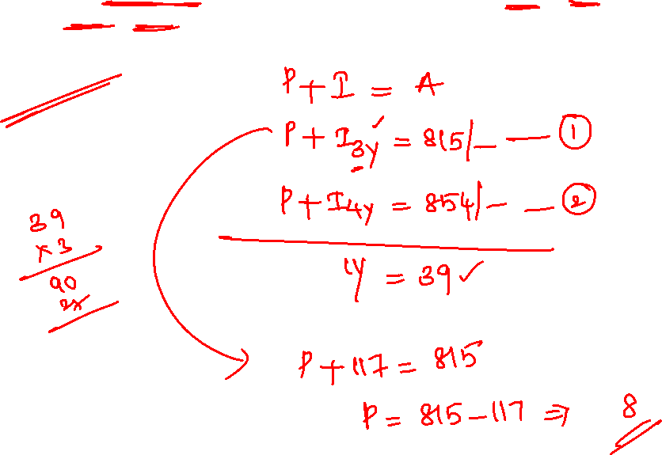
14. A sum of money at simple interest amounts to Rs.815 in 3 years and to Rs.854 in 4 years. The sum is
Rs. 650
Rs. 698
Rs. 690
Rs. 700

Slide 18
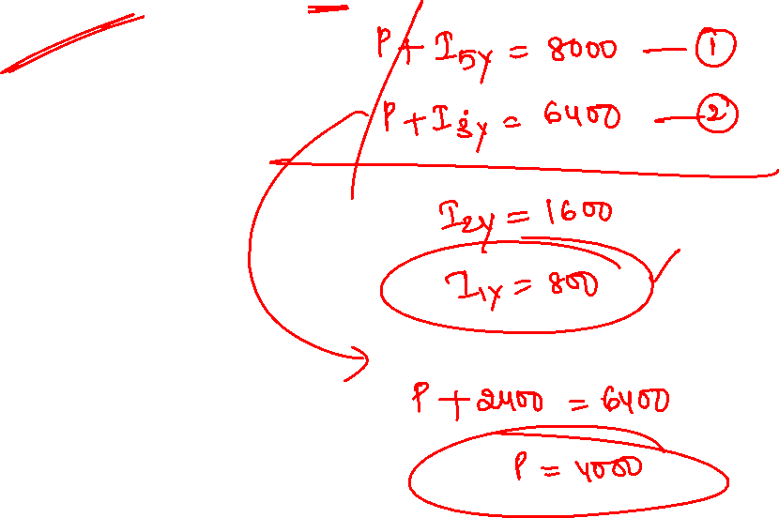
15. A sum of money at simple interest amounts to Rs.8000 in 5 years and to Rs.6400 in 3 years. The sum is
Rs. 4000
Rs. 5000
Rs. 6000
Rs. 7500

Slide 19
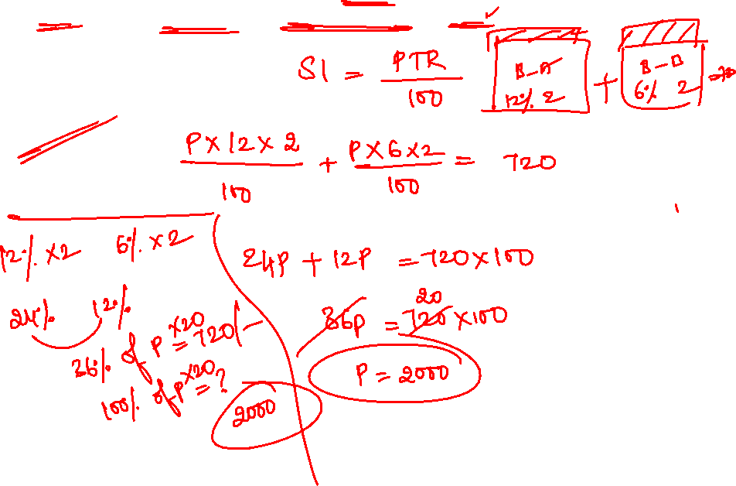
16. Raju lent some of the money at 12% SI and equal amount of money of 6% SI each for 2 years. If his total interest was Rs. 720. What amount was lent in each case
Rs. 4000
Rs. 5000
Rs. 2000
Rs. 7500

Slide 20
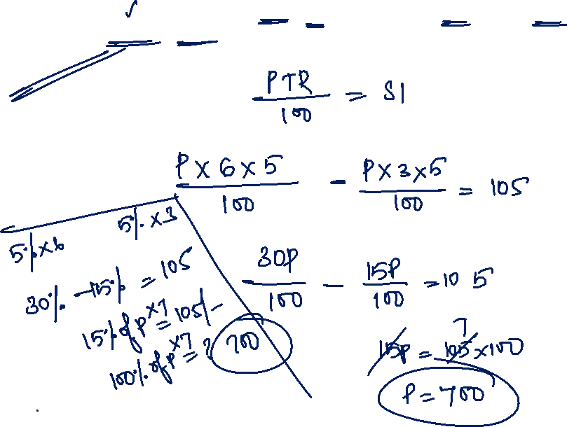
17. Simple interest certain sum at 5% per annum for 3 years and 6 years differ by 105. The sum is?
Rs. 700
Rs. 500
Rs. 600
Rs. 750

Slide 21
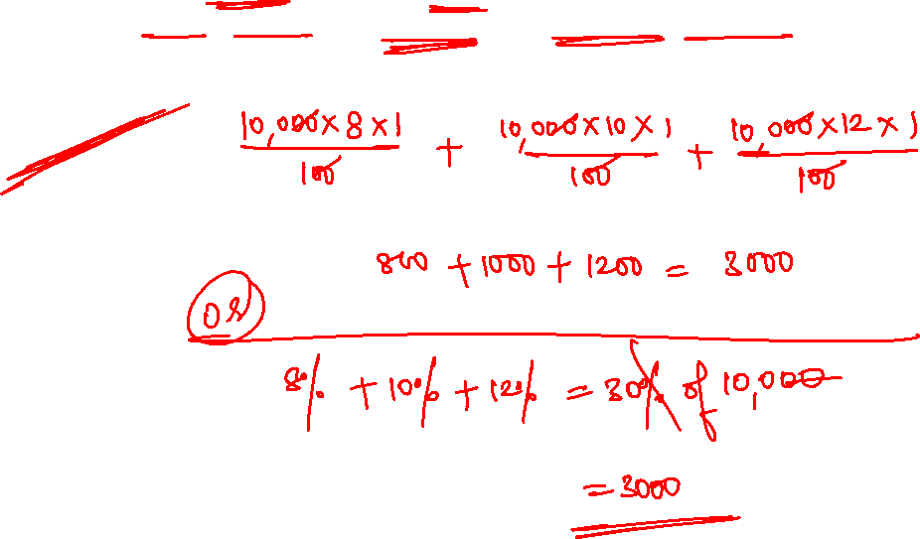
18. Find the simple interest on a sum of Rs. 10000, if the rate of interest being 8% p.a., 10% p.a., and 12% p.a. for the first year, second year and third year respectively.
Rs.300
Rs.3000
Rs.13000
Rs. 4500

Slide 22
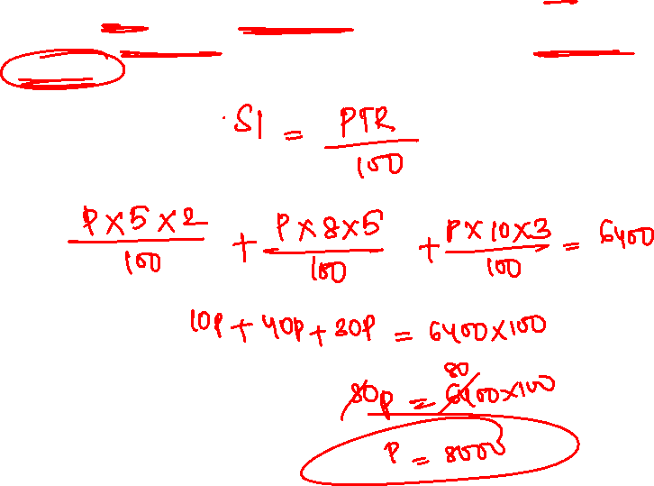
19. Ahmed borrowed some money at the rate of 5% p.a. for first two years, at the rate of 8% p.a. for next five years, and at the rate of 10% p.a. for the period beyond seven years. If he pays a total interest of Rs.6400 at the end of ten years, how much money did he borrow?
Rs.8000
Rs.10000
Rs. 12000
Rs.15000

Slide 23


